Slide 1
WIRE WINDING
MAGNETIC FIELD LINES
MAGNET

Slide 2
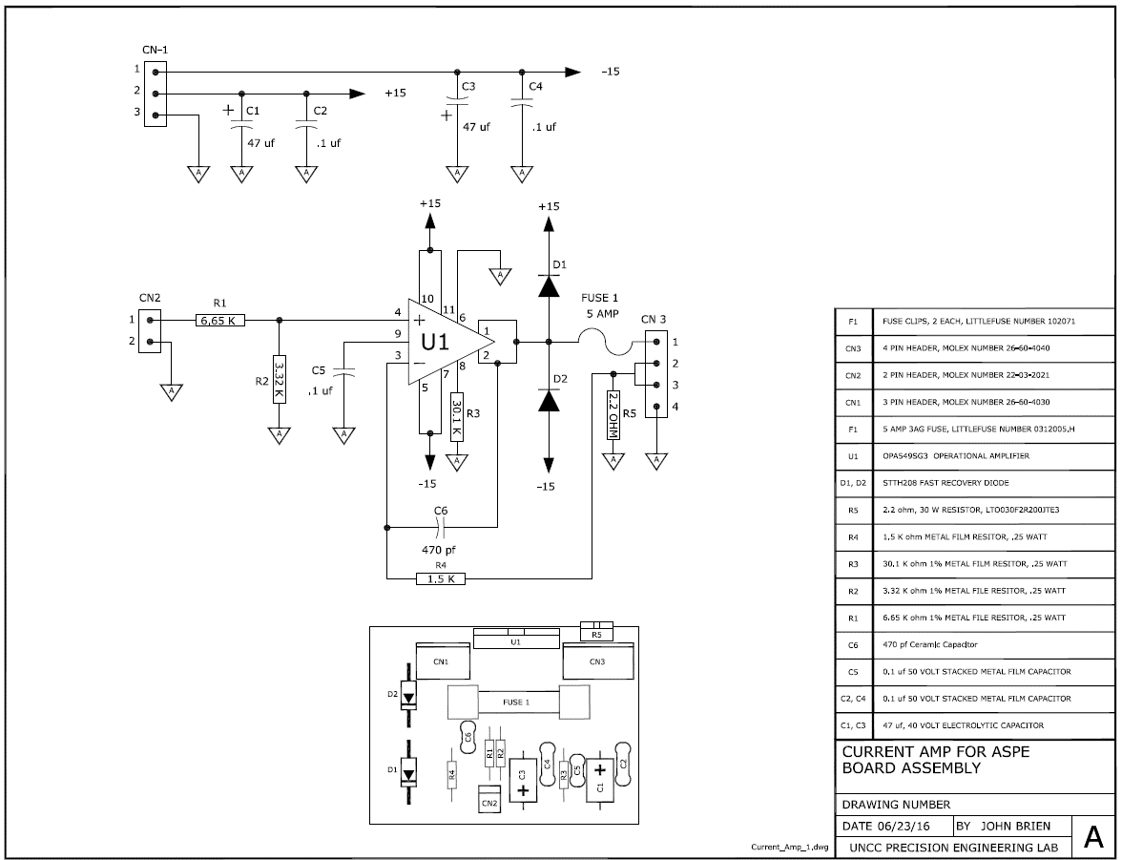

Slide 3
BODY
BODY
GUARD
GUARD
SENSOR
PLATE

Slide 4
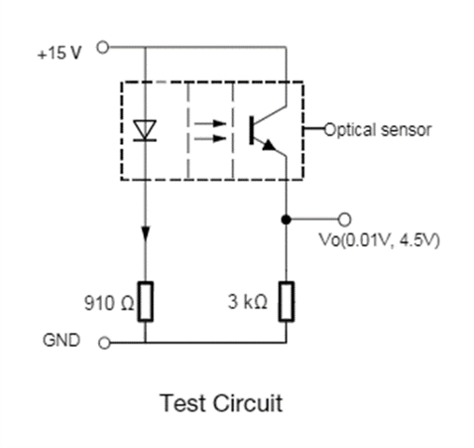

x
sensor
LED
15V
GND
Vo

Slide 5
x
15V
GND
Vo

Slide 6
Photo detector
Pinhole 2
Pinhole 1
Focusing lens
Epoxy wedge
Outer sleeve
Laser source
Glass
specimen
obj. lens
Beam splitter

Slide 7
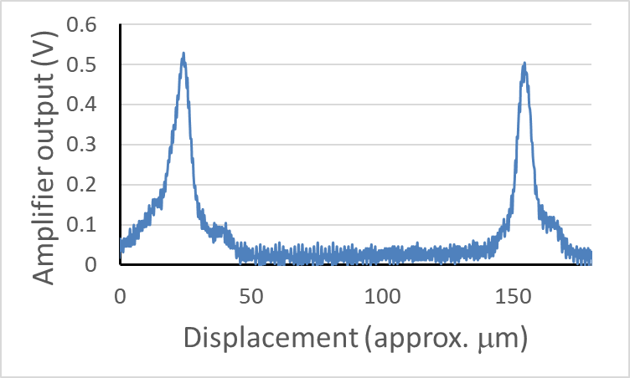

Slide 8
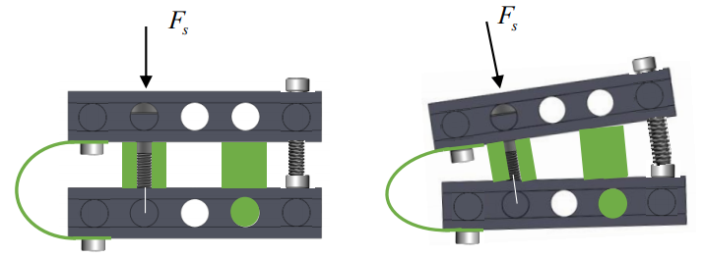
θ
z
x

Slide 9
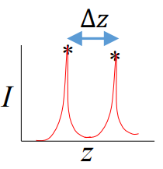
V
t
Signal
Voltage
V
DAC
V
Current
Amplifier
i
Voice
Coil
F
Flexure
z
Find
Peaks
z, V
FPGA
z, V
ADC
z
Displacement Sensor
V
Confocal
Sensor
I

Slide 10
Desktop Computer
Real Time System
FPGA
Measurement state machine
Data acquisition and control loop
Control voice coil
Send ramp to FPGA
Idle
Read FPGA FIFO
Configure
Acquire confocal intensity data
Start measurement
Data
Queue
Wait for data
Load data
Acquire displacement data
Data logging loop
Process data
Write measurement data to file
Exit

